Slide 1
Topic 1: Foundation
Lecture
4
Network (Socket) Programming
User process
User process
socket
socket
Operating
System
Operating
System

Slide 2
Today’s lecture outline
Background: IP, TCP and UDP characteristics
Berkeley Socket Interface
Common System Calls
Python example code

Slide 3
Today’s lecture’s objective
Goal: Learn how to build client/server application that communicate using sockets
Socket API
introduced in BSD4.1 UNIX, 1981
explicitly created, used, released by apps
client/server paradigm
two types of transport service via socket API:
unreliable datagram
reliable, byte stream-oriented

Slide 4
Background:
IP, TCP and UDP Characteristics
Notes:
See the notes of first slide.

Slide 5
Where does Socket API lie?
Socket API
DATA
A
Application
T
Transport
N
Network
DL
CRC
Data Link
Physical (bits)
Notes:
A TCP/IP application must provide its own presentation- and session-layer services if it needs to use them. Many times the data that are interchanged are simple enough not to require presentation layer services, and the interactions are short so no session-layer services are needed. The TCP/IP application layer therefore corresponds to the top three layers of the OSI model. From an application point of view the distinction between datalink and physical layer is irrelevant. They are both collapsed into a single subnetwork layer.
The really important point is that the application can treat the transport-layer API as its way to communicate with remote processes. The layered complexity is essentially invisible to the application code, and is called on by the transport layer libraries without any action being required by the application..
The subnetwork layer data is actually an IP datagram, whose data is a TCP or UDP segment, whose data is an application protocol data unit.

Slide 6
IP characteristics
Datagram-based
Connectionless
Unreliable
Best efforts delivery; No delivery guarantees
Logical (32-bit) addresses
Unrelated to physical addressing
Leading bits determine network membership
Notes:
The network layer of TCP/IP makes no guarantees of delivery: at any hop along the way a packet may be discarded, either because transmission errors have been detected or simply because the receiving equipment does not have the capacity to process it.
In such circumstances the originating host may or may not receive an ICMP (Internet Control Message Protocol) message detailing the reason for non-delivery. ICMP messages can be useful in helping hosts to change to more appropriate behavior, but are not always actioned even when raised.
Since different physical network use different addressing schemes it's important that IP provides a unified scheme independent of the underlying hardware. This is crucial when building large internets (an "internet" with a small "I" is any interconnected collection of IP networks). You can find a detailed description of IP addressing at
http://www.holdenweb.com/students/3comip.pdf

Slide 7
UDP characteristics
Also datagram-based
Connectionless, unreliable
Applications usually message-based
No transport-layer retries
Applications handle (or ignore) errors
Processes identified by port number
Services live at specific ports
Usually below 1024, requiring privilege
Notes:
You can think of UDP as similar to the postal service – packets go out, they can be lost along the way if an intermediate router runs out of resources or if they are mangled by noise, no acknowledgements are issued. UDP applications are therefore usually simpler messaging-style applications, where the only recovery action will be a fixed number of retries.
DNS is a good example -- although it can use TCP, most DNS traffic is carried by UDP. If a server does not reply, or if the reply (or the request) gets lost, the consequences are usually not tragic. If you fail to resolve a host name because of such an error you (as a user) will usually be quite happy to try again, and this failure will not have been significant.
As you will see later, a server binds to a specific port when it starts up. Originally a client had to "just know" what port the server would be listening on, and so default port numbers were allocated: 80 for HTTP, 25 for SMTP and so on. Later on, services like the PortMapper were introduced so that a server could use any port, and register it with the Portmapper – the clients would start with a PortMapper enquiry to find out which port their server was listening on.

Slide 8
TCP characteristics
Connection-oriented
Two endpoints of a virtual circuit
Reliable
Application needs no error checking
Stream-based
No predefined blocksize
Processes identified by port numbers
Services live at specific ports
Notes:
A TCP conversation requires specific endpoints, so you can think of it as more like a telephone call: one system calls another, and has to get a reply before communication can take place.
Because of the need for defined endpoints, TCP has no broadcast capability, unlike UDP. Because TCP is a reliable protocol the possibility of error is rather low (though not zero) – errors are detected and corrected in the transport layer. This makes it relatively easy to use, since the applications can assume the data they send will, eventually, be received in the absence of a complete connectivity failure.
TCP is a much more sophisticated protocol than UDP and includes both error detection and correction, relieving applications of housekeeping tasks which would otherwise quickly become burdensome. There is no need to transmit data is any particular block size, and an application is free to send as few as one byte or as much as several megabytes at a time. The transport layer will take responsibility for buffering this data and sending it out as a stream of packets of an appropriate size.

Slide 9
Berkeley
Socket Interface
Notes:
Berkeley API is the de-facto sockets standard.
In 1980s, DARPA funded a group at University of California Berkeley to transport TCP/ IP software to UNIX to make the resulting software available to other sites.
The designers decided to use existing system calls whenever possible and to add new system calls to support TCP/ IP functions that did not fit easily into the existing set of functions. The result became known as the Berkeley interface, or Berkeley socket API, and the system is called BSD (Berkeley Software Distribution)
Two design choices:
Define functions specifically for TCP/ IP
Define functions that support network communications in general and use parameters that make TCP/ IP a special case.
The Berkeley socket interface provides generalized functions that support network communication using many possible protocols. Socket calls refer to TCP/IP as a family of protocols.
BSD is not the only interface (API) available for network communication (although, it is the most common). There is also TLI (Transport Layer Interface) , also called XTI (X/ Open Transport Interface) in recognition of work done by X/Open, developed by AT&T.
BSD Unix contains a separate system function socket that applications call to create a socket; an application only uses open to create file descriptors.
The general idea underlying sockets is that a single system call is sufficient to create any socket. Once a socket has been created, an application must make additional system calls to specify the details of its exact usage.
Once a socket has been created, it can be used to wait for an incoming connection (passive socket) or to initiate a connection (active socket).
Specifying an end-point:
When a socket is created, it does not contain detailed information about how it will be used. In particular, the socket does not contain information about the protocol port numbers or IP address of either the local machine or the remote machine. Before an application uses a socket, it must specify one or both of these addresses.
TCP/ IP protocols define communication end point as IP address plus a protocol port number. Because sockets interface is general, AF_INET is used for TCP/ IP addressing.
PF_INET is TCP/ IP protocol family and AF_INET is the TCP/ IP address family.

Slide 10
Major System Calls
General
Socket call
Write call
Read call
Close calls
Server
Bind call
Listen call
Accept call
Client
Connect call
Notes:
Socket call: An application calls socket to create a new socket than can be used for network communication. The call returns a descriptor for the newly created socket. Arguments to the call include the protocol family that the application will use (PF_INET for TCP/ IP) and the protocol or type of service it will need (SOCK_DGRAM for UDP and SOCK_STREAM for TCP).
Connect call: After creating a socket, a client calls connect to establish an active connection to a remote server. The argument to connect allows the client to specify the remote endpoint which includes the remote machine’s IP address and protocol port number. Once a connection is made, data can be sent on it.
Write call: Write call is used by both servers and clients to send data across a TCP connection. Clients usually use write to send requests and servers use it to send replies. A call to write requires three arguments: 1) socket descriptor, 2) address of data to be sent, and 3) length of data.
Read call: Read call is used by both server and client to receive data on a TCP or UDP connection.
Close call: Once a client or server finishes using a socket, it calls close to deallocate it. If only process is using the socket, close immediately terminates the connection and deallocates the socket.
Bind call: When a socket is created, it does not have any notion of end point addresses (neither the local nor remote address are assigned). An application calls bind to specify the local end point for a socket. The call takes argument that specify socket descriptor and an end point address. This call is primarily used by servers to specify the well-known port at which they will await connections.
Listen call: When a socket is created, it is neither active (i.e., ready for use by a client) nor passive (ready for use by a server) until the application takes further action. Connection-oriented servers call listen to place a socket in passive mode and make it ready to accept incoming connections. Most servers consist of an infinite loop that accepts the next incoming connection, handles it, and then returns to accept the next connection. Even if handling takes a few ms, it may be that a new connection request comes during the time server is handling an existing request. To ensure that no connection request is lost, a server must pass listen an argument that tells the OS to enqueue connections requests for a socket.
Accept call: For TCP sockets, after a server calls socket to create a socket, bind to specify a local endpoint address, and listen to place it in passive mode, the server calls accept to extract the next incoming connection request. An argument to accept specifies the socket from which a connection should be accepted. Accept creates a new socket for each new connection request, and returns the descriptor of the new socket to its caller. The server uses the new socket only for the new connection; it uses the original socket to accept additional connection requests.

Slide 11
Major System Calls
response
Client
Server
request
socket() connect() send() recv()
close()
socket() bind() listen() accept() recv() send()
close()
Connection establishment
Data request
Data response
End-of-file notification

Slide 12
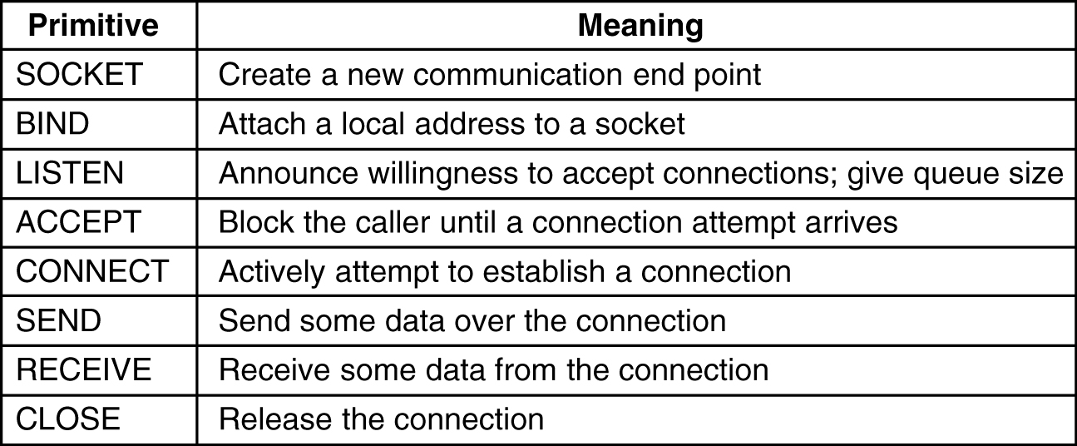
Major System Calls (Summary)

Slide 13
Python
Example Code
Credit: http://holdenweb.com/py/networking/

Slide 14
Connectionless Service
socket()
socket()
bind()
bind()
recvfrom()
sendto()
[blocked]
recvfrom()
[blocked]
sendto()
SERVER
CLIENT
Notes:
Notes credit: http://holdenweb.com/py/networking/
When UDP is used, the server creates a socket and binds address(es) and a port number to it. The server then waits for incoming data (remember: UDP is connectionless).
The clients also create a socket, then they bind it to the appropriate interface – typically allowing the transport layer to choose an epehemeral (short-lived) port number rather than specifying a particular port.
The client sends data to the server, which awakes from its blocked state and starts to compute its response. Meantime the client has issued a recvfrom() using the same address it sent the data to, and is blocked awaiting the response which should eventually arrive from the server.
When the server sends its result back, it goes to the address and port number the incoming data was received from. The server then loops around to wait for another request. The arrival of the server’s data unblocks the client, which can then continue.
This is something of a simplification: using a library based on the select() system call it is possible to use sockets in a non-blocking fashion. This does complicate the code somewhat, however.

Slide 15
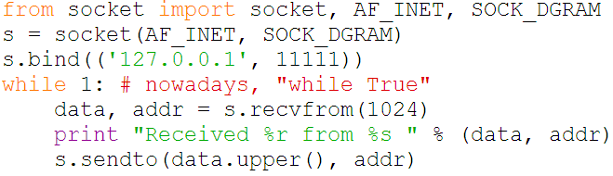
Simple Connectionless Server
UDP server
Notes:
Notes credit: http://holdenweb.com/py/networking/
Initially, we will import the socket method and AF_INET and SOCK_DGRAM constants from the socket class.
Then we will create a new datagram (UDP) socket; the identifier for this newly creates socket is s
Since we are creating a UDP server here, we have to bind this socket to an end point identifier. The end point identifer here is identified by the tuple (‘127.0.0.1’, 11111); the IP address here is 127.0.0.1 which refer to the local machine (called localhost) and the port number is 11111.
Then the server begins a blocking loop.

Slide 16
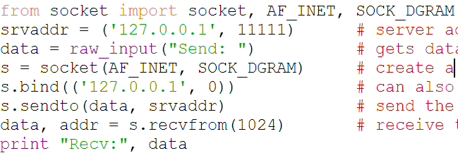
Simple Connectionless Client
UDP client
Notes:
Notes credit: http://holdenweb.com/py/networking/
The client specifies port number zero to indicate that it simply wants an ephemeral port – this is more efficient than attempting to use a specific port number because the port requested might already be in use and then the bind() call would fail.
The getsocketname() call tells the user the address and port number being used for the client end of the communication. While this isn't an essential part of the program it's useful debugging data.
The client simply sends the data and (usually) receives a reply from the server. This particular program is somewhat inadequate in terms of error checking: if the server's response is somehow lost then the client will hang forever. The socket library was recently (2.3) updated to include timeout features that previously had only been available in third-party additions.

Slide 17
Connection-oriented Service
socket()
Server
Client
bind()
socket()
listen()
connect()
accept()
write()
[blocked]
read()
read()
[blocked]
[blocked]
When interaction is over, server loops to accept a new connection
write()
Notes:
Notes credit: http://holdenweb.com/py/networking/
A connection-oriented server creates a socket, binds it to one or more local ports on which it will listen for connections, and then puts the socket into the listening state to wait for incoming connections. At this point the server process blocks until a connection request arrives.
A client creates its own socket, usually without specifying any particular port number, and then connects to the endpoint the server is listening on. The server’s accept() call returns a new socket that the server can use to send data across this particular connection..
The two parties then exchange data using read() and write() calls.
The major limitation of this structure is the non-overlapped nature of the request handling in the server. Theoretically it's possible for the server to use its original socket to listen for further requests while the current request is being handled, but that isn't shown here. You will learn how to overcome this limitation using standard library classes.

Slide 18
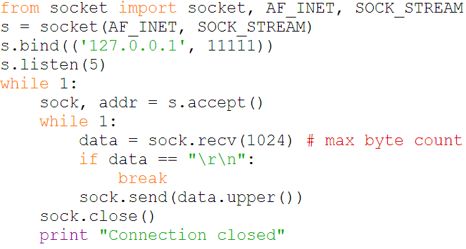
Connection-oriented server
TCP server
Notes:
Notes credit: http://holdenweb.com/py/networking/
Connection-oriented servers are a little more complex because the connection allows clients and servers to interact across multiple send() and recv() calls.
The server blocks in accept() until a server connects. The return value from accept() is a tuple consisting of a socket and the client address (which is the usual (address, port) tuple).
The server can, if it chooses, use multitasking techniques such as creating a new thread or forking a new process to allow it to handle several concurrent connections. Either solution allows the connection to be processed while the main control loop returns to execute another accept() and deal with the next client connection.
Since each connection generates a new server-side socket there is no conflict between the different conversations, and the server can continue to use the listen()ing socket to listen for incoming connections while it serves already-connected clients.

Slide 19
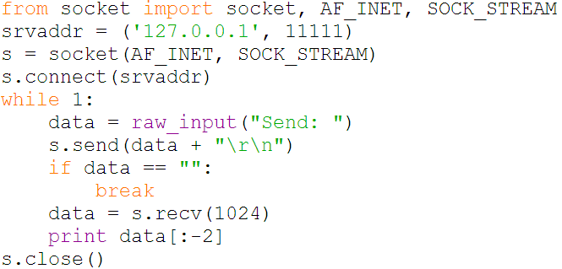
Connection-oriented client
TCP client
Notes:
Notes credit: http://holdenweb.com/py/networking/
This very simple client just sends a single message and receives a single response.
More typical code will send a request and use its understanding of the application protocol to determine when the response to that request has been completed.
Protocols like HTTP 1.0 use a separate connection for each request. Protocols like telnet can exchange thousands of messages before the connection is closed, and the code tends to be more complex iin that case.
Under normal circumstances a recv() call guarantees that at least one byte of data will be returned. When a program seems the empty string (zero bytes) returned from the recv() it knows that the other end has terminated the connection by calling close() on its socket.

Slide 20
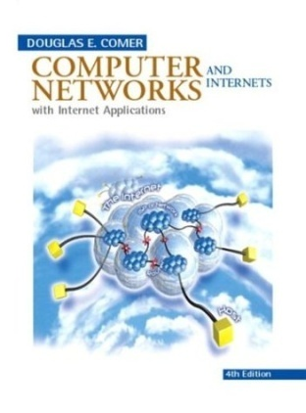

References
Chapter on Sockets [Comer]
Chapter 2: Application layer [K&R]

Slide 21
?
?
Questions/ Confusions?
?
Use the discussion forum at:
http://compnets.ning.com/
Credits/ Acknowledgement at:
http://sites.google.com/site/cse320site/

